Slide 1
Lesson 11
How to create databases, tables, and indexes
Lecture adapted from Murach’s MySQL Textbooks

Slide 2
Objectives
Applied
Given the design for a database, write the DDL statements to create the tables, constraints, and indexes that are required.
Write a script that includes all of the DDL statements for creating the tables of a database.
Use MySQL Workbench to work with the columns, data, constraints, and indexes for a table.

Slide 3
Objectives (continued)
Knowledge
Describe how each of these types of constraints restricts the values that can be stored in a table: not null, unique, primary key, and foreign key.
Describe the difference between a column-level constraint and a table-level constraint.
Describe the use of an index.
Describe the use of a script for creating the tables of a database.
Describe three character sets that are commonly used with MySQL and the pros and cons of each character set.
Describe how a collation works with a character set.
Describe two storage engines that are commonly used with MySQL and the pros and cons of each engine.

Slide 4
How to use the CREATE DATABASE statement
Syntax
CREATE DATABASE [IF NOT EXISTS] db_name
Attempt to create a database named AP
CREATE DATABASE ap
Create a database named AP only if it doesn’t exist
CREATE DATABASE IF NOT EXISTS ap

Slide 5
How to use the DROP DATABASE statement
Syntax
DROP DATABASE [IF EXISTS] db_name
Attempt to drop a database named AP
DROP DATABASE ap
Drop a database named AP only if it exists
DROP DATABASE IF EXISTS ap

Slide 6
How to use the USE statement
Syntax
USE db_name
Select a database named AP
USE ap

Slide 7
The syntax of the CREATE TABLE statement
CREATE TABLE [db_name.]table_name
(
column_name_1 data_type [column_attributes]
[, column_name_2 data_type [column_attributes]]...
[, table_level_constraints]
)
Common column attributes
NOT NULL
UNIQUE
DEFAULT default_value
AUTO_INCREMENT

Slide 8
A statement that creates a table without column attributes
CREATE TABLE vendors
(
vendor_id INT,
vendor_name VARCHAR(50)
)
A statement that creates a table with column attributes
CREATE TABLE vendors
(
vendor_id INT
NOT NULL UNIQUE AUTO_INCREMENT,
vendor_name VARCHAR(50) NOT NULL UNIQUE
)

Slide 9
Another statement that creates a table with column attributes
CREATE TABLE invoices
(
invoice_id INT NOT NULL UNIQUE,
vendor_id INT NOT NULL,
invoice_number VARCHAR(50) NOT NULL,
invoice_date DATE,
invoice_total DECIMAL(9,2) NOT NULL,
payment_total DECIMAL(9,2) DEFAULT 0
)

Slide 11
Constraints, Modifying Tables and Indexes

Slide 12
The syntax of a column-level primary key constraint
column_name data_type PRIMARY KEY column_attributes
A table with column-level constraints
CREATE TABLE vendors
(
vendor_id INT PRIMARY KEY AUTO_INCREMENT,
vendor_name VARCHAR(50) NOT NULL UNIQUE
)

Slide 13
The syntax of a table-level primary key constraint
[CONSTRAINT [constraint_name]]
PRIMARY KEY (column_name_1[, column_name_2]...)
A table with table-level constraints
CREATE TABLE vendors
(
vendor_id INT AUTO_INCREMENT,
vendor_name VARCHAR(50) NOT NULL,
CONSTRAINT vendors_pk PRIMARY KEY (vendor_id),
CONSTRAINT vendor_name_uq UNIQUE (vendor_name)
)

Slide 14
A table with a two-column primary key constraint
CREATE TABLE invoice_line_items
(
invoice_id INT NOT NULL,
invoice_sequence INT NOT NULL,
line_item_description VARCHAR(100) NOT NULL,
CONSTRAINT line_items_pk
PRIMARY KEY (invoice_id, invoice_sequence)
)

Slide 15
The syntax of a column-level foreign key constraint
[CONSTRAINT] REFERENCES table_name (column_name)
[ON DELETE {CASCADE|SET NULL}]
A table with a column-level foreign key constraint
CREATE TABLE invoices
(
invoice_id INT PRIMARY KEY,
vendor_id INT REFERENCES vendors (vendor_id),
invoice_number VARCHAR(50) NOT NULL UNIQUE
)

Slide 16
The syntax of a table-level foreign key constraint
[CONSTRAINT constraint_name]
FOREIGN KEY (column_name_1[, column_name_2]...)
REFERENCES table_name (column_name_1
[, column_name_2]...)
[ON DELETE {CASCADE|SET NULL}]
A table with a table-level foreign key constraint
CREATE TABLE invoices
(
invoice_id INT PRIMARY KEY,
vendor_id INT NOT NULL,
invoice_number VARCHAR(50) NOT NULL UNIQUE,
CONSTRAINT invoices_fk_vendors
FOREIGN KEY (vendor_id)
REFERENCES vendors (vendor_id)
)

Slide 17
An INSERT statement that fails because a related row doesn’t exist
INSERT INTO invoices
VALUES (1, 1, '1')
The response from the system
Error Code: 1452. Cannot add or update a child row: a foreign key constraint fails ('ex'.'invoices', CONSTRAINT 'invoices_fk_vendors' FOREIGN KEY ('vendor_id') REFERENCES 'vendors' ('vendor_id'))

Slide 18
A constraint that uses the ON DELETE clause
CONSTRAINT invoices_fk_vendors
FOREIGN KEY (vendor_id) REFERENCES vendors (vendor_id)
ON DELETE CASCADE

Slide 19
Terms to know about constraints
Column-level constraint
Table-level constraint
Not null constraint
Unique constraint
Primary key constraint
Foreign key constraint

Slide 20
The syntax for modifying the columns of a table
ALTER TABLE [db_name.]table_name
{
ADD column_name data_type [column_attributes] |
DROP COLUMN column_name |
MODIFY column_name data_type [column_attributes] |
RENAME COLUMN old_column_name TO new_column_name
}

Slide 21
A statement that adds a new column
ALTER TABLE vendors
ADD last_transaction_date DATE
A statement that drops a column
ALTER TABLE vendors
DROP COLUMN last_transaction_date

Slide 22
A statement that changes the length of a column
ALTER TABLE vendors
MODIFY vendor_name VARCHAR(100) NOT NULL
A statement that changes the type of a column
ALTER TABLE vendors
MODIFY vendor_name CHAR(100) NOT NULL
A statement that changes the default value
ALTER TABLE vendors
MODIFY vendor_name VARCHAR(100) NOT NULL
DEFAULT 'New Vendor'

Slide 23
A statement that changes the name of a column
ALTER TABLE vendors
RENAME COLUMN vendor_name TO v_name
A statement that fails because it would lose data
ALTER TABLE vendors
MODIFY v_name VARCHAR(10) NOT NULL
The response from the system
Error Code: 1265. Data truncated for column 'v_name' at row 1

Slide 24
The syntax for modifying the constraints of a table
ALTER TABLE [dbname.]table_name
{
ADD PRIMARY KEY constraint_definition |
ADD [CONSTRAINT constraint_name]
FOREIGN KEY constraint_definition |
DROP PRIMARY KEY |
DROP FOREIGN KEY constraint_name
}

Slide 25
A statement that adds a primary key constraint
ALTER TABLE vendors
ADD PRIMARY KEY (vendor_id)
A statement that adds a foreign key constraint
ALTER TABLE invoices
ADD CONSTRAINT invoices_fk_vendors
FOREIGN KEY (vendor_id) REFERENCES vendors (vendor_id)

Slide 26
A statement that drops a primary key constraint
ALTER TABLE vendors
DROP PRIMARY KEY
A statement that drops a foreign key constraint
ALTER TABLE invoices
DROP FOREIGN KEY invoices_fk_vendors

Slide 27
A statement that renames a table
RENAME TABLE vendors TO vendor
A statement that deletes all data from a table
TRUNCATE TABLE vendor
A statement that deletes a table from the current database
DROP TABLE vendor

Slide 28
A statement that qualifies the table to be deleted
DROP TABLE ex.vendor
A statement that returns an error due to a foreign key reference
DROP TABLE vendors
The response from the system
Error Code: 3730. Cannot drop table 'vendors' referenced by a foreign key constraint 'invoices_fk_vendors' on table 'invoices'

Slide 29
The syntax of the CREATE INDEX statement
CREATE [UNIQUE] INDEX index_name
ON [dbname.]table_name (column_name_1 [ASC|DESC][,
column_name_2 [ASC|DESC]]...)
A statement that creates an index based on a single column
CREATE INDEX invoices_invoice_date_ix
ON invoices (invoice_date)
A statement that creates an index based on two columns
CREATE INDEX invs_ven_id_inv_num_ix
ON invoices (vendor_id, invoice_number)

Slide 30
A statement that creates a unique index
CREATE UNIQUE INDEX vens_ven_phone_ix
ON vendors (vendor_phone)
A statement that creates an index that’s sorted in descending order
CREATE INDEX invoices_invoice_total_ix
ON invoices (invoice_total DESC)
A statement that drops an index
DROP INDEX vens_ven_phone_ix ON vendors

Slide 31
The script that creates the AP database (part 1)
-- create the database
DROP DATABASE IF EXISTS ap;
CREATE DATABASE ap;
-- select the database
USE ap;
-- create the tables
CREATE TABLE general_ledger_accounts
(
account_number INT PRIMARY KEY,
account_description VARCHAR(50) UNIQUE
);
CREATE TABLE terms
(
terms_id INT PRIMARY KEY
AUTO_INCREMENT,
terms_description VARCHAR(50) NOT NULL,
terms_due_days INT NOT NULL

Slide 32
The script that creates the AP database (part 2)
CREATE TABLE vendors
(
vendor_id INT PRIMARY KEY
AUTO_INCREMENT,
vendor_name VARCHAR(50) NOT NULL
UNIQUE,
vendor_address1 VARCHAR(50),
vendor_address2 VARCHAR(50),
vendor_city VARCHAR(50) NOT NULL,
vendor_state CHAR(2) NOT NULL,
vendor_zip_code VARCHAR(20) NOT NULL,
vendor_phone VARCHAR(50),
vendor_contact_last_name VARCHAR(50),
vendor_contact_first_name VARCHAR(50),
default_terms_id INT NOT NULL,
default_account_number INT NOT NULL,
CONSTRAINT vendors_fk_terms
FOREIGN KEY (default_terms_id)
REFERENCES terms (terms_id),
CONSTRAINT vendors_fk_accounts
FOREIGN KEY (default_account_number)
REFERENCES general_ledger_accounts (account_number)
);

Slide 33
The script that creates the AP database (part 3)
CREATE TABLE invoices
(
invoice_id INT PRIMARY KEY
AUTO_INCREMENT,
vendor_id INT NOT NULL,
invoice_number VARCHAR(50) NOT NULL,
invoice_date DATE NOT NULL,
invoice_total DECIMAL(9,2) NOT NULL,
payment_total DECIMAL(9,2) NOT NULL DEFAULT 0,
credit_total DECIMAL(9,2) NOT NULL DEFAULT 0,
terms_id INT NOT NULL,
invoice_due_date DATE NOT NULL,
payment_date DATE,
CONSTRAINT invoices_fk_vendors
FOREIGN KEY (vendor_id)
REFERENCES vendors (vendor_id),
CONSTRAINT invoices_fk_terms
FOREIGN KEY (terms_id)
REFERENCES terms (terms_id)
);

Slide 34
The script that creates the AP database (part 4)
CREATE TABLE invoice_line_items
(
invoice_id INT NOT NULL,
invoice_sequence INT NOT NULL,
account_number INT NOT NULL,
line_item_amount DECIMAL(9,2) NOT NULL,
line_item_description VARCHAR(100) NOT NULL,
CONSTRAINT line_items_pk
PRIMARY KEY (invoice_id, invoice_sequence),
CONSTRAINT line_items_fk_invoices
FOREIGN KEY (invoice_id)
REFERENCES invoices (invoice_id),
CONSTRAINT line_items_fk_acounts
FOREIGN KEY (account_number)
REFERENCES general_ledger_accounts (account_number)
);
-- create an index
CREATE INDEX invoices_invoice_date_ix
ON invoices (invoice_date DESC);

Slide 35
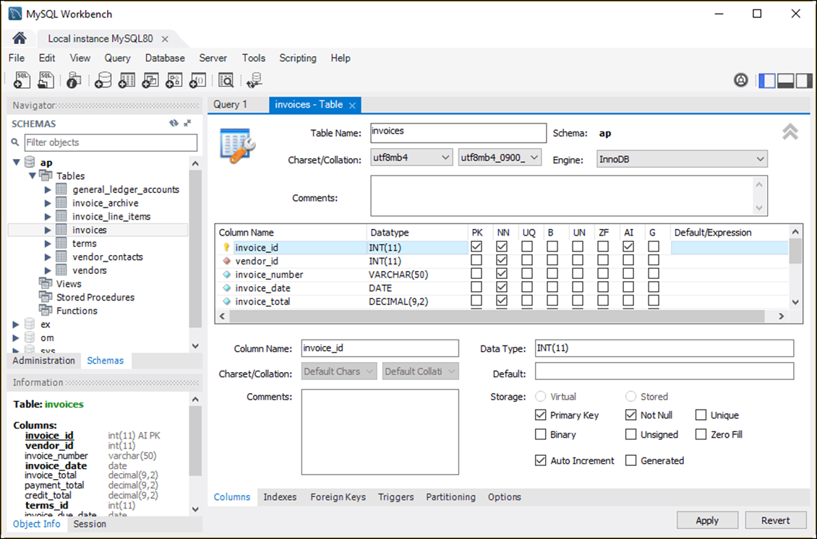
The column definitions for the Invoices table

Slide 36
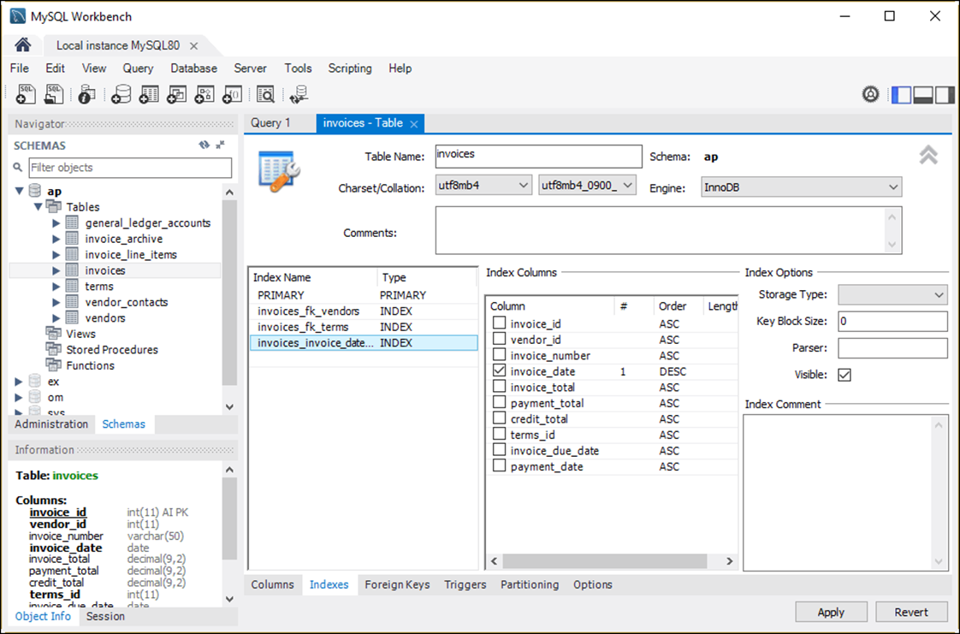
The indexes for the Invoices table

Slide 37
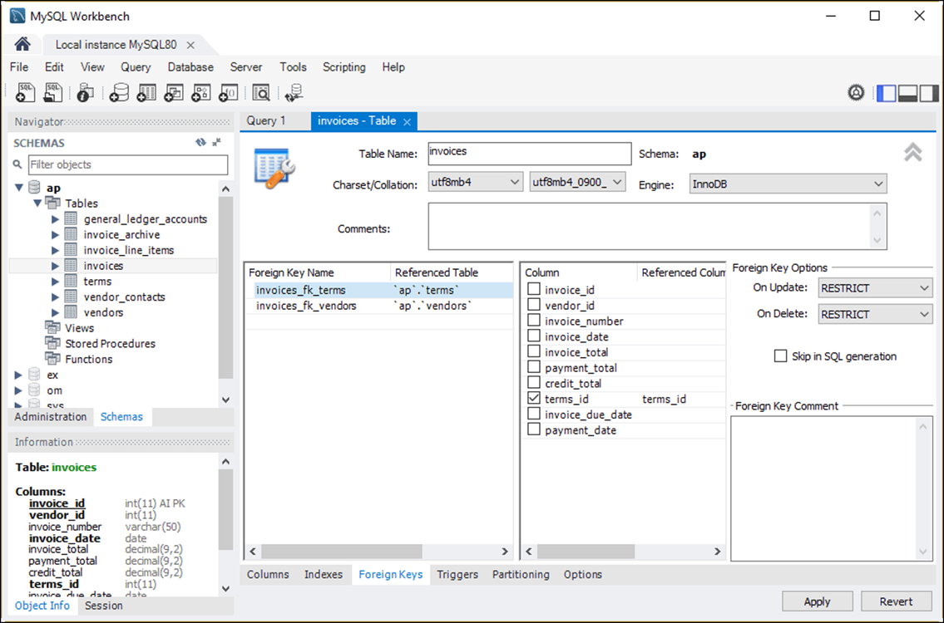
The foreign keys for the Invoices table

Slide 39
Collations & Character Sets

Slide 40
Three commonly used character sets
latin1
utf8mb3
utf8mb4

Slide 41
Four collations for the latin1 character set
latin1_swedish_ci
latin1_general_ci
latin1_general_cs
latin1_bin

Slide 42
Four collations for the utf8mb3 character set
utf8_general_ci
utf8_unicode_ci
utf8_spanish_ci
utf8_bin

Slide 43
Three collations for the utf8mb4 character set
utf8mb4_0900_ai_ci
utf8mb4_0900_as_cs
utf8mb4_bin

Slide 44
Collation names
If the name ends with ci, the collation is case-insensitive.
If the name ends with cs, the collation is case-sensitive.
If the name includes ai, the collation is accent-insensitive.
If the name includes as, the collation is accent-sensitive.
If the name ends with bin, the collation is binary.

Slide 45
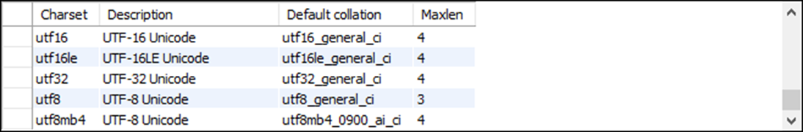
How to view all available character sets for a server
SHOW CHARSET
How to view a specific character set
SHOW CHARSET LIKE 'utf8mb4'

Slide 46
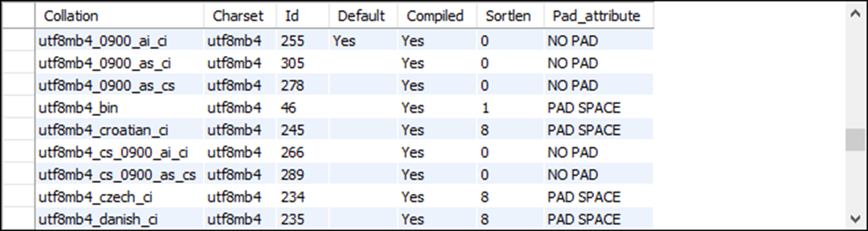
How to view all available collations for a server
SHOW CHARSET
How to view all available collations for a specific character set
SHOW CHARSET LIKE 'utf8mb4'

Slide 47
How to view the default character set for a server
SHOW VARIABLES LIKE 'character_set_server'
How to view the default collation for a server
SHOW VARIABLES LIKE 'collation_server'
How to view the default character set for a database
SHOW VARIABLES LIKE 'character_set_database'
How to view the default collation for a database
SHOW VARIABLES LIKE 'collation_database'

Slide 48
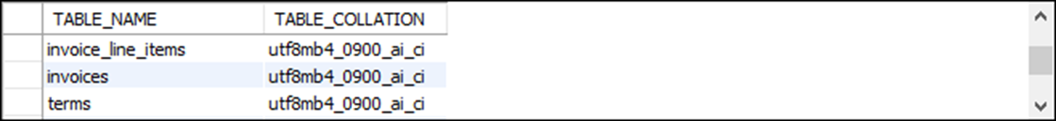
How to view the character set and collation for all the tables in a database
SELECT table_name, table_collation
FROM information_schema.tables
WHERE table_schema = 'ap'

Slide 49
The clauses used to specify a character set and collation
[CHARSET character_set] [COLLATE collation]
How to specify a character set and collation at the database level
For a new database
CREATE DATABASE ar CHARSET latin1 COLLATE latin1_general_ci
For an existing database
ALTER DATABASE ar CHARSET utf8mb4 COLLATE utf8mb4_0900_ai_ci
For an existing database using the CHARSET clause only
ALTER DATABASE ar CHARSET utf8mb4
For an existing database using the COLLATE clause only
ALTER DATABASE ar COLLATE utf8mb4_0900_ai_ci

Slide 50
How to specify a character set and collation at the table level
For a new table
CREATE TABLE employees
(
emp_id INT PRIMARY KEY,
emp_name VARCHAR(25)
)
CHARSET latin1 COLLATE latin1_general_ci
For an existing table
ALTER TABLE employees
CHARSET utf8mb4 COLLATE utf8mb4_0900_ai_ci

Slide 51
How to specify a character set and collation at the column level
For a column in a new table
CREATE TABLE employees
(
emp_id INT PRIMARY KEY,
emp_name VARCHAR(25) CHARSET latin1 COLLATE latin1_general_ci
)
For a column in an existing table
ALTER TABLE employees
MODIFY emp_name VARCHAR(25) CHARSET utf8mb4 COLLATE utf8mb4_0900_ai_ci

Slide 53
Storage Engines

Slide 54
Two commonly used storage engines
InnoDB
MyISAM

Slide 55
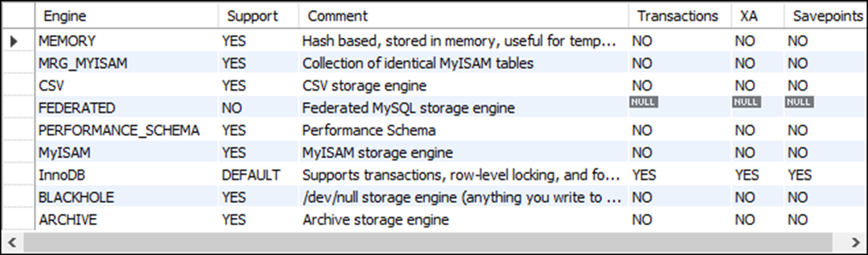
How to view all storage engines for a server
SHOW ENGINES
How to view the default storage engine for a server
SHOW VARIABLES LIKE 'default_storage_engine'

Slide 56
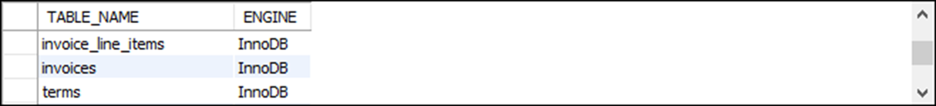
How to view the storage engine for all the tables in a database
SELECT table_name, engine
FROM information_schema.tables
WHERE table_schema = 'ap'

Slide 57
The clause used to specify a storage engine
ENGINE = engine_name
How to specify a storage engine for a table
For a new table
CREATE TABLE product_descriptions
(
product_id INT PRIMARY KEY,
product_description VARCHAR(200)
)
ENGINE = MyISAM
For an existing table
ALTER TABLE product_descriptions ENGINE = InnoDB
How to set the default storage engine for the current session
SET SESSION default_storage_engine = InnoDB

